Slide 1
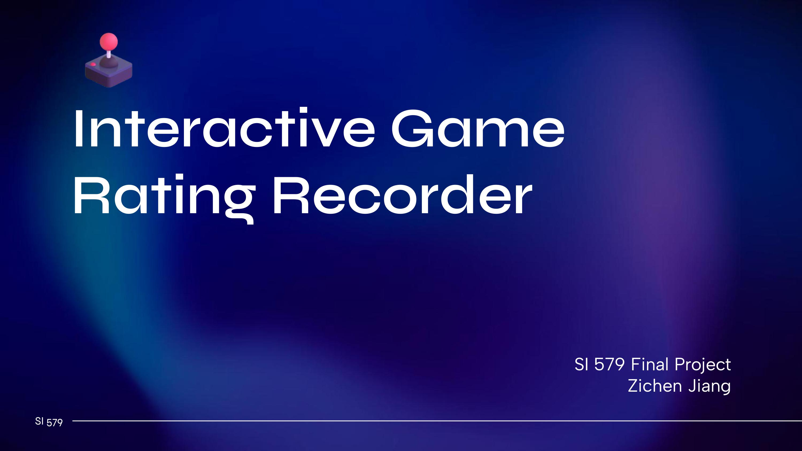
Notes:
Hi everyone! I’m Zichen Jiang, and this is my final project: the Interactive Game Rating Recorder. It’s a simple web app that lets users log, sort, and manage their game experiences.

Slide 2
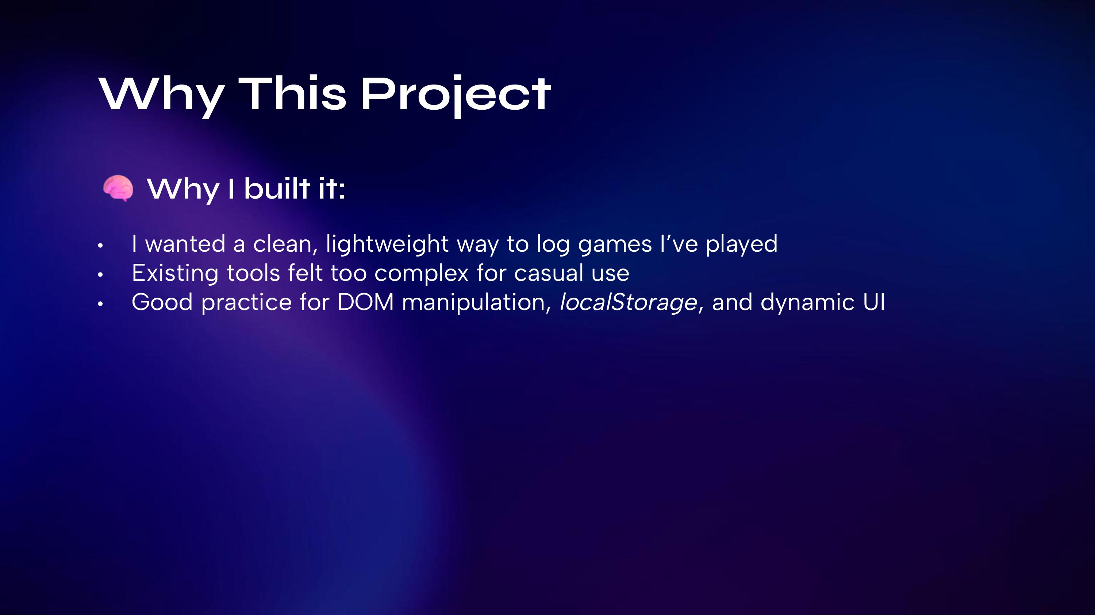
Notes:
I picked this idea because I sometimes want to write quick notes about games I play. While most game review platforms are too big or complicated. I also wanted to practice the things we learned in class, like forms, buttons, saving data, and sorting.

Slide 3
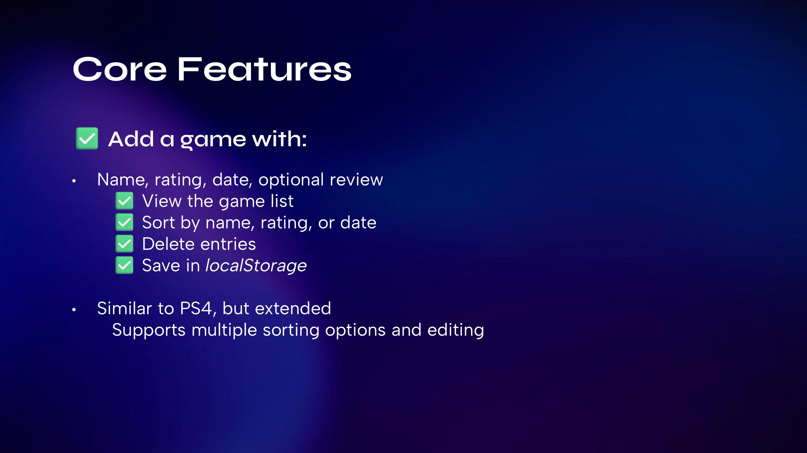
Notes:
Here’s what it can do so far: users can add a game entry with all the details, sort the list however they want, and delete records. All of it is stored locally, so the data persists even after reloading the page.
This project might look a little like Problem Set 4, but it goes further. Users can edit entries, and sort by date, name, or rating — which wasn’t in the assignment.

Slide 4
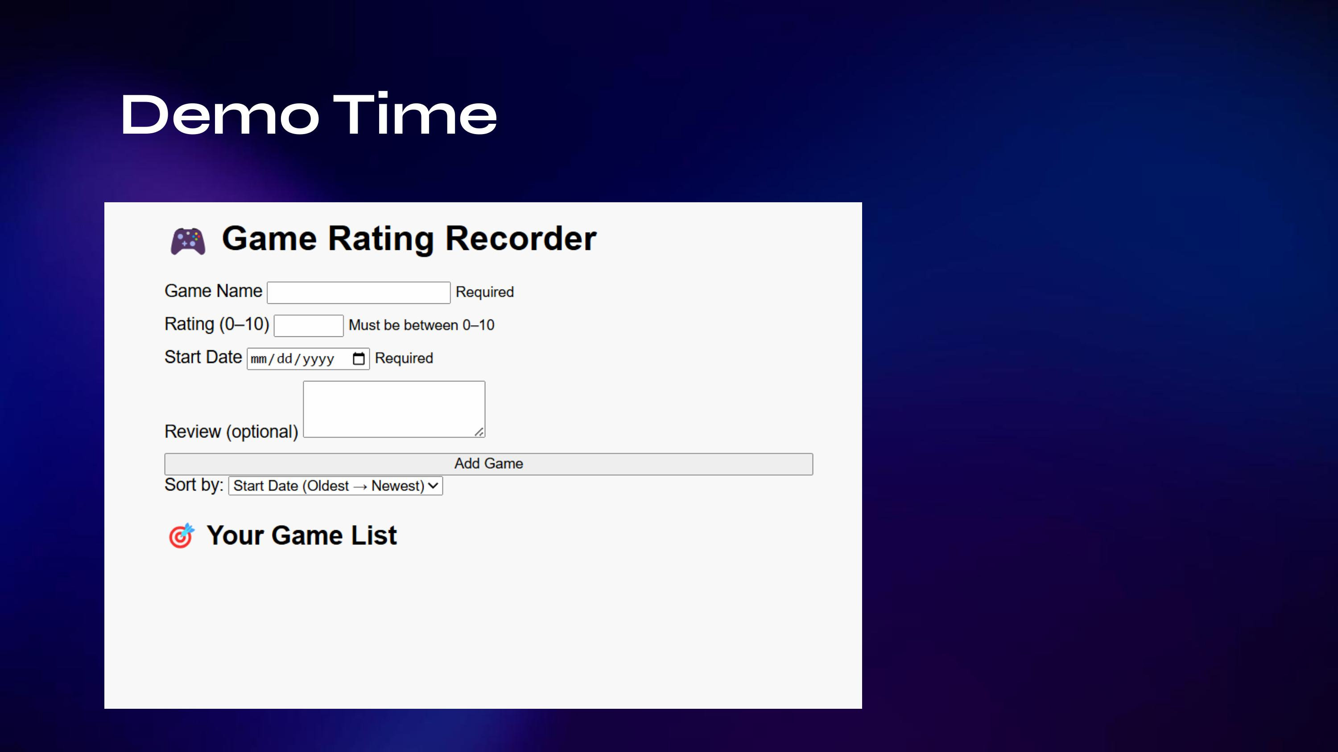
Notes:
Let me show you how it works. Here is the demo page for now.

Slide 5
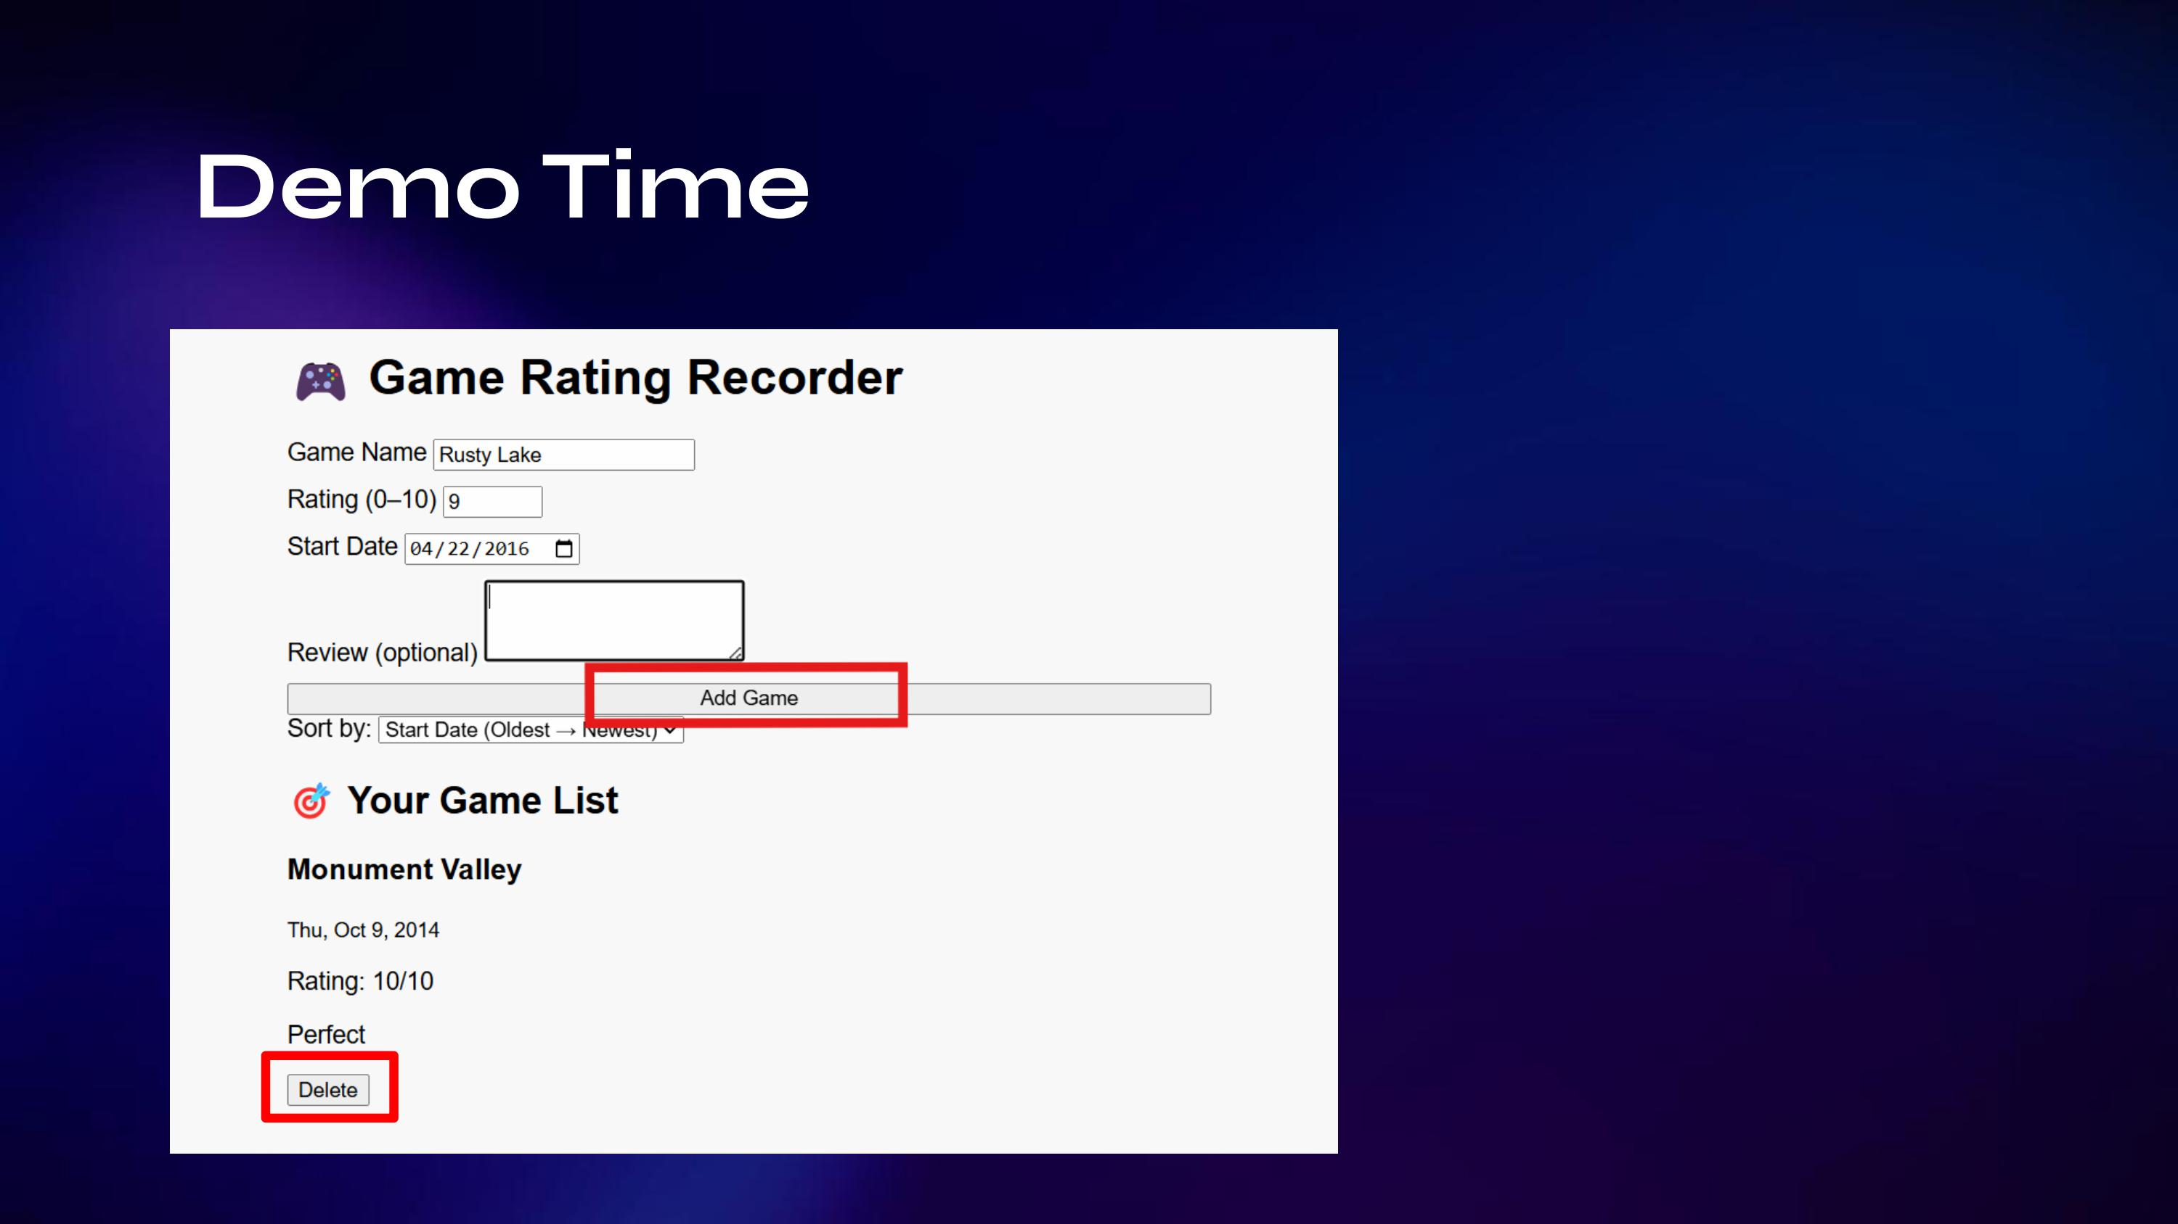

Slide 6
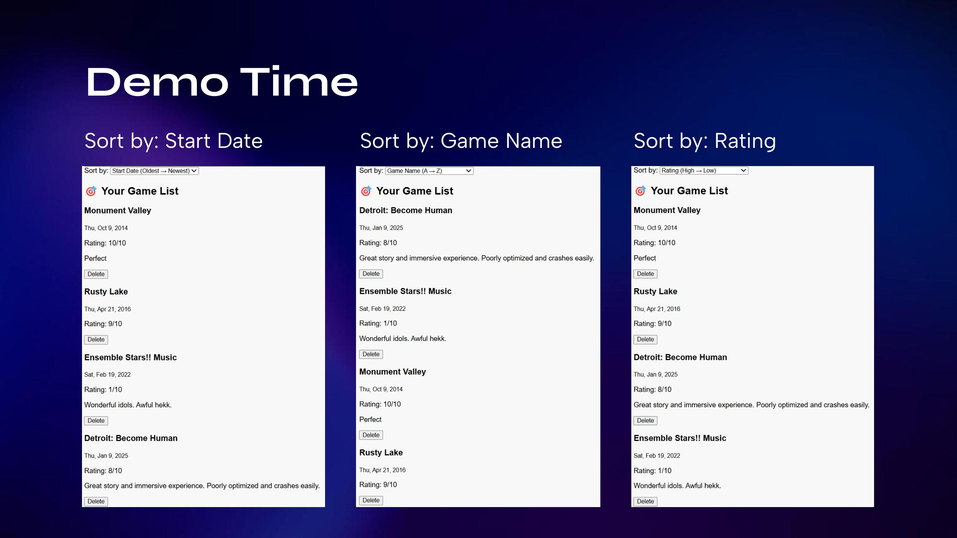

Slide 7
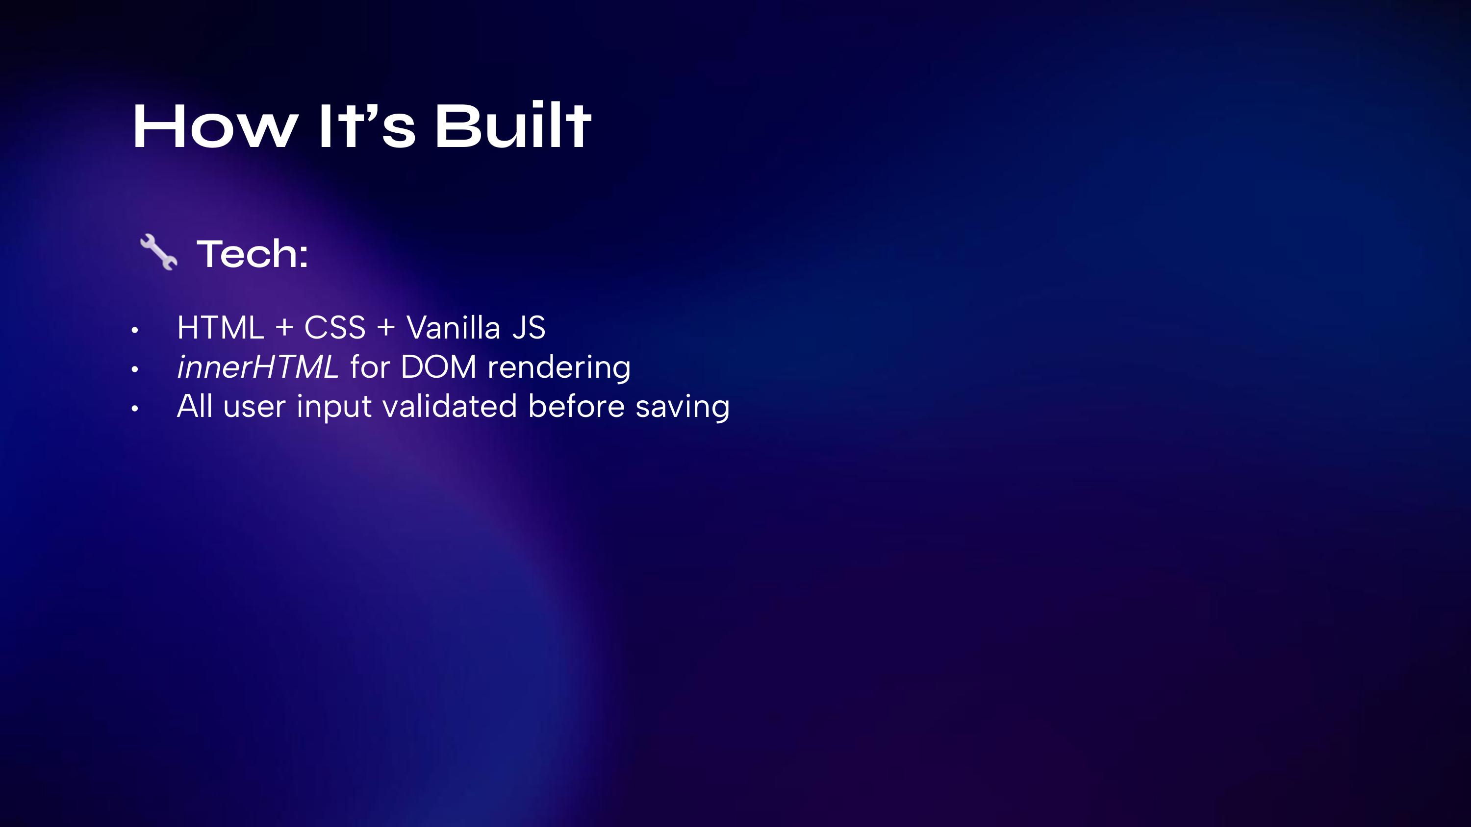
Notes:
The project uses only vanilla JavaScript. All DOM updates are done with innerHTML. I also made sure form inputs are validated to prevent bad data.

Slide 8
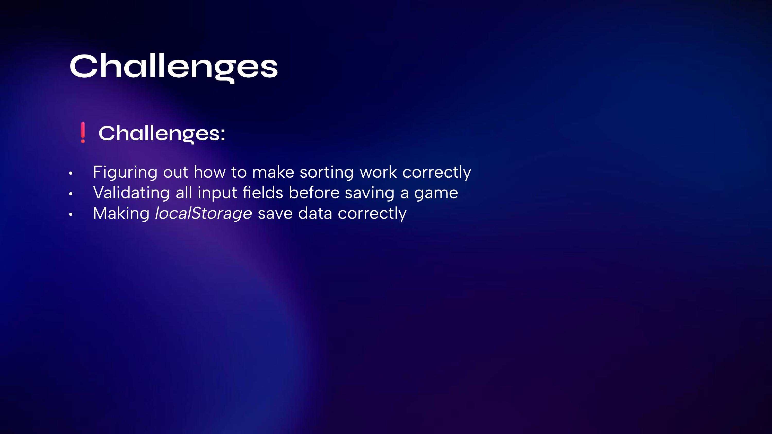
Notes:
One challenge was getting the sort feature to work as expected — especially the rating sort. I also spent time making sure all inputs were validated before saving. And at first, localStorage wasn’t saving the data — I realized I forgot to update it after each change.

Slide 9

Notes:
Next, I’m adding an Edit button so users can update entries — that’s important for making the project more interactive and distinct from earlier assignments. I’ll also work on styling and getting everything ready for final delivery.

Slide 10
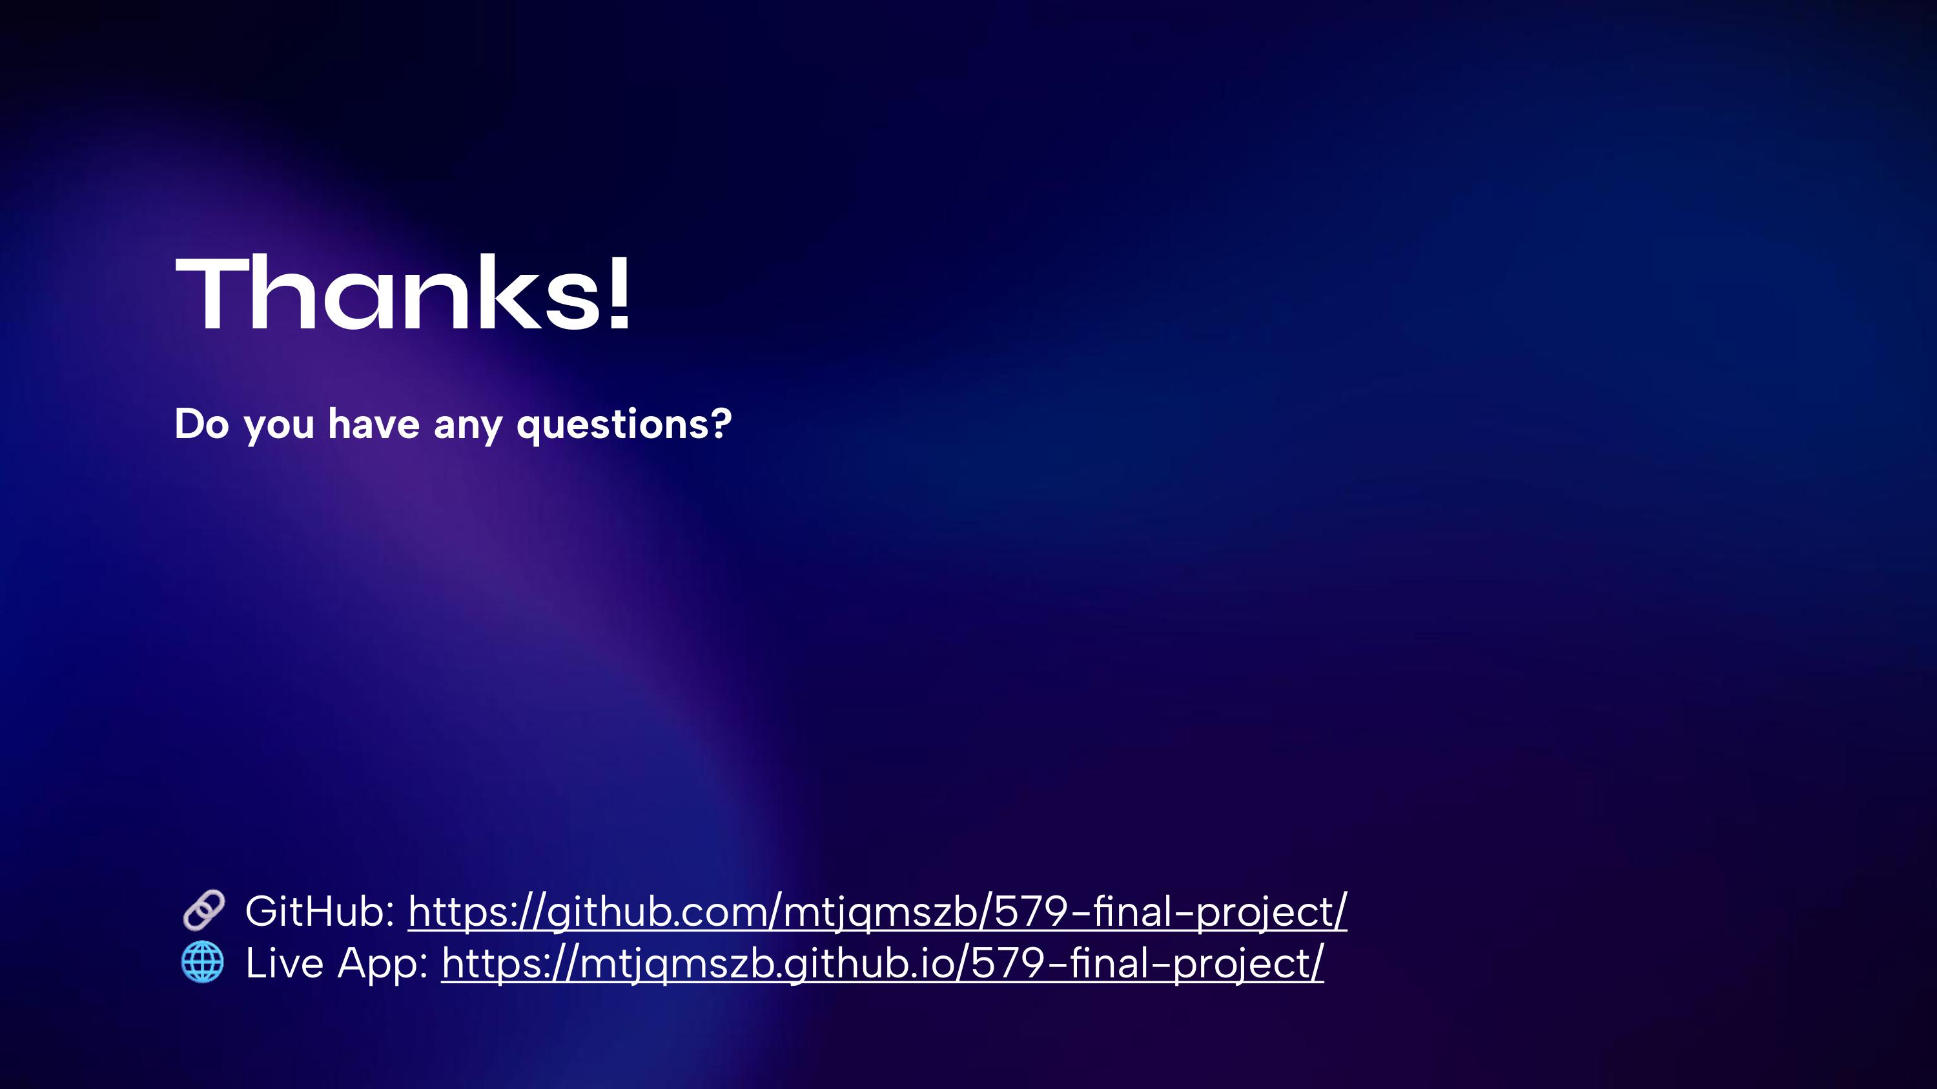
Notes:
Thanks for checking out my project! The code is live on GitHub and the demo is available on GitHub Pages. Let me know if you have any questions!

